Slide 1
Identifying Spatial Patterns on Choropleth Maps: A Comparison between humans and deep learning models
Survey Experiment Instruction (Tentative)

Slide 2
Introduction: What's included here
Slides included here include screenshots of the online survey and explanations.
Each experiment contains five sections:
Informed consent form
Instruction
Background information
Questions for maps
Completion code
This file (the slides) will be used as the instruction material.
In the remaining slides, we will introduce the other sections.

Slide 3
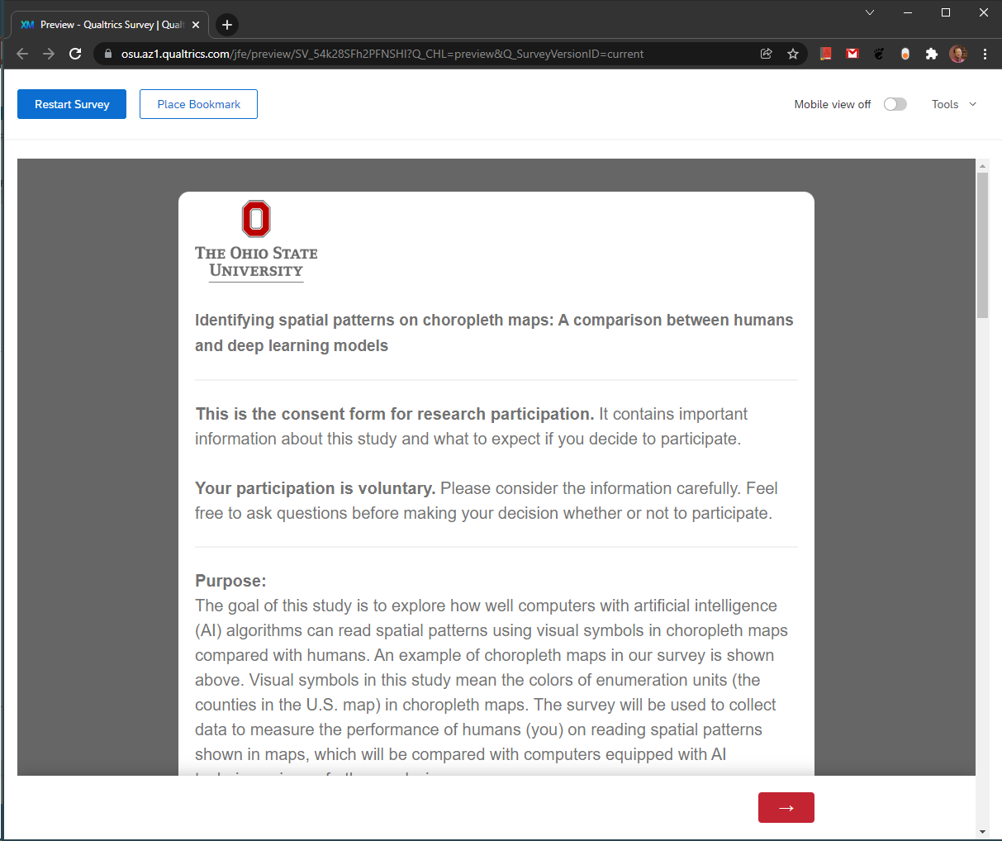
Consent form
Participants will see the consent form as the first page when they log on to the web page.
They can scroll down to read the consent form (also included in the IRB application).
They will be instructed that, if they agree to continue, they can click on the red ARROW to start the survey.

Slide 4
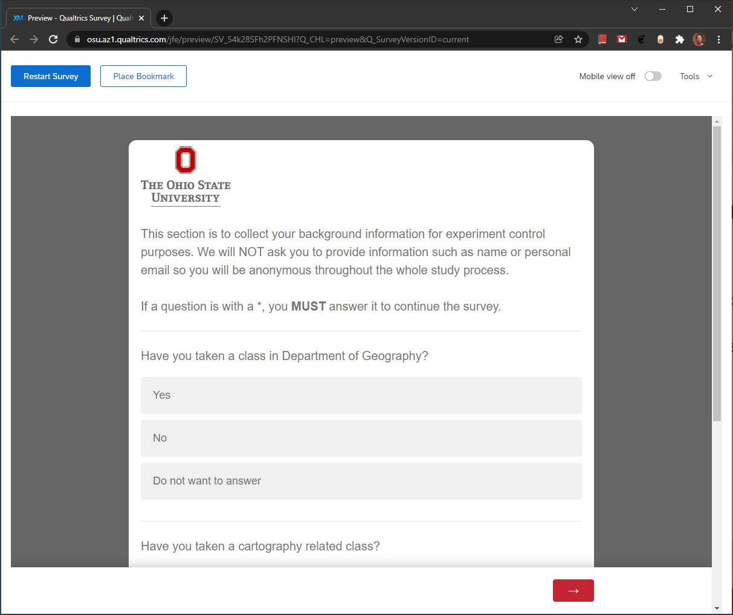
Background information
The participants will be asked about their background in geography and cartography, which will be used for experiment control purposes.
There are three questions in this section:
Have you taken a class in Department of Geography?
Have you taken a cartography related class?
Is this survey your class assignment from either GeoVisualization (GEOG 5201) or Design and Implementation of GIS (GEOG 5223)?

Slide 5
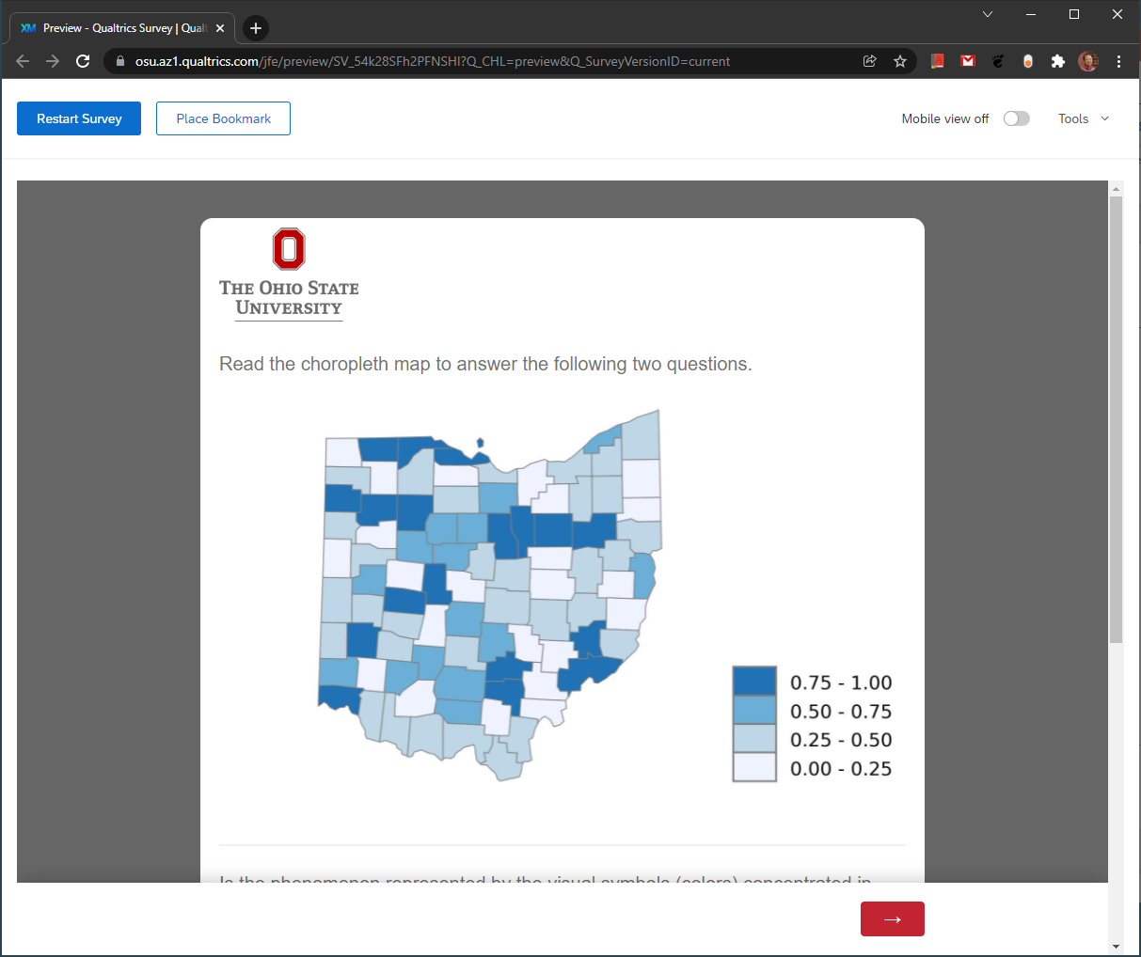
Main questions
This is how the questions for map will look like.
There are totally 16 maps and 32 questions in 16 pages.
Participants will be presented two questions for one map in one page.
Participants must answer the two questions for one map before continuing to the next page with the next map and questions.
In the next few slides we will explain the different kinds of maps that participants will see in this survey.

Slide 6
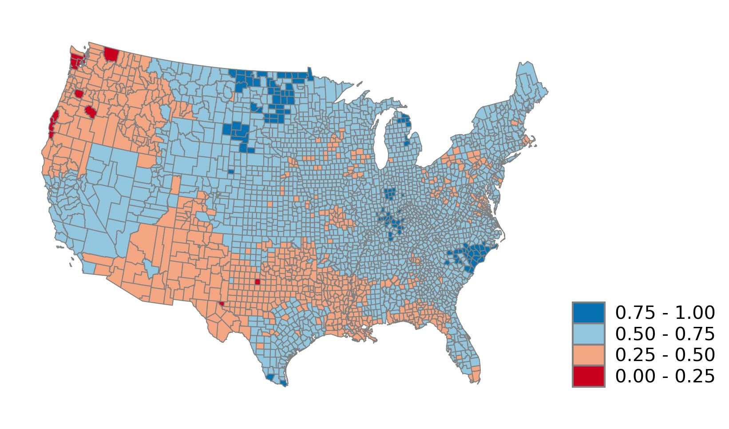
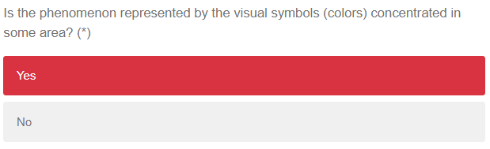
Example 1
The same colors rendering U.S. counties are concentrated in some area.
For example, the light red color is concentrated in the north west and south of the conterminous U.S.
Notes:
Five map examples

Slide 7
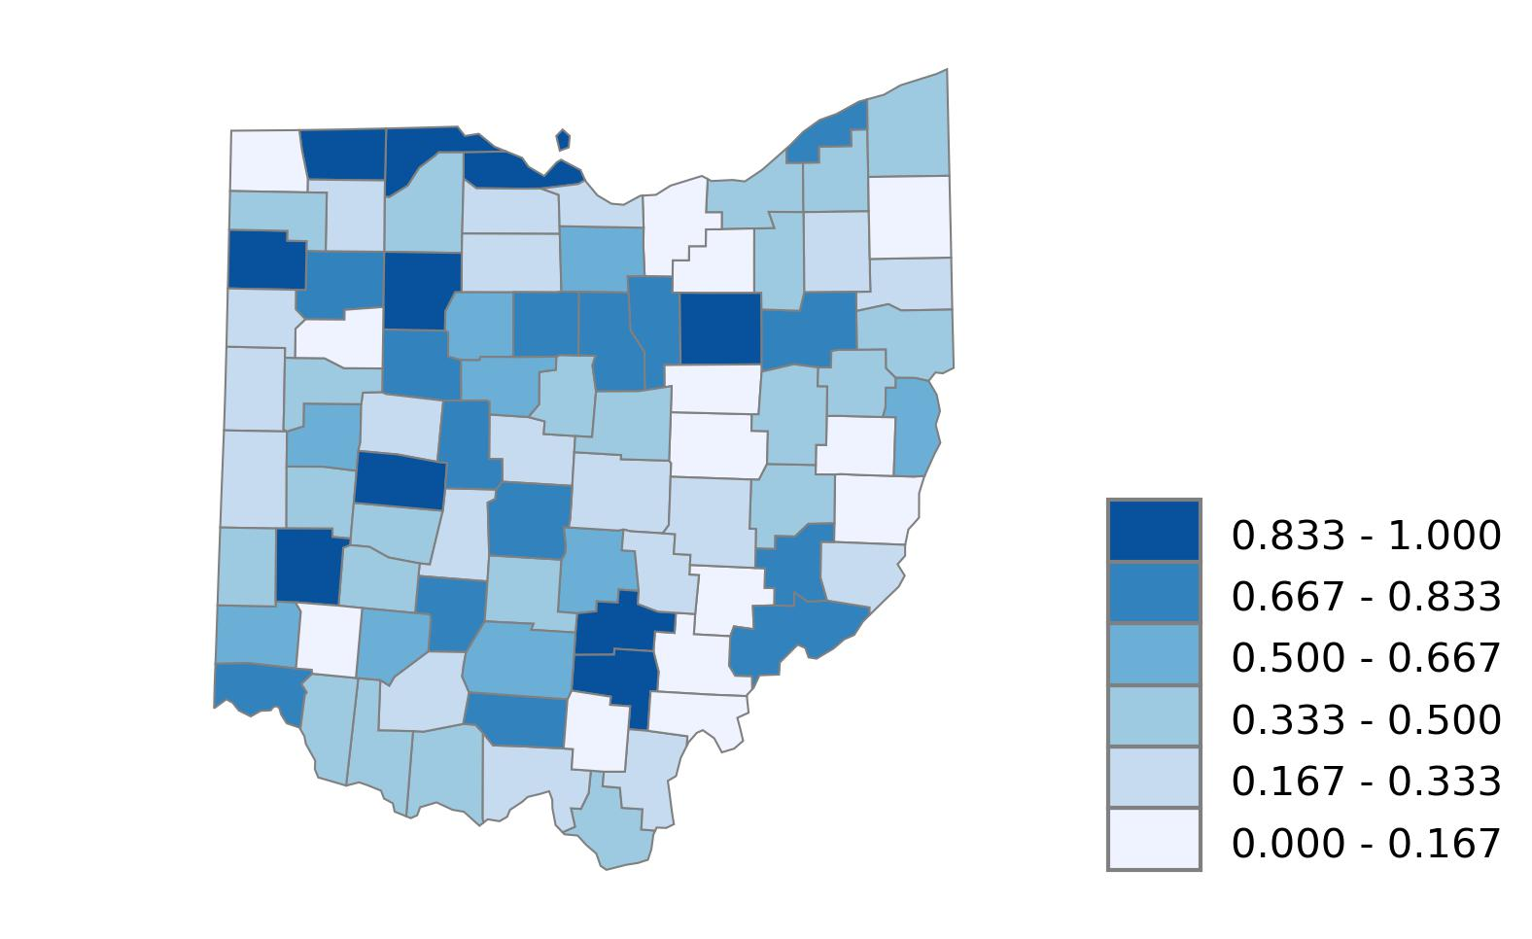
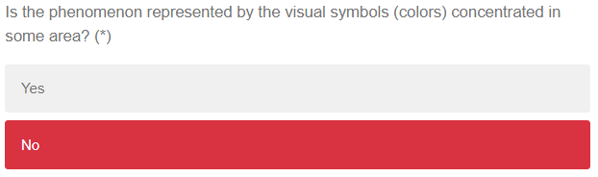
Example 2
The color for each class scatters over Ohio.
There is no significant concentration in this map.
Notes:
Five map examples

Slide 8
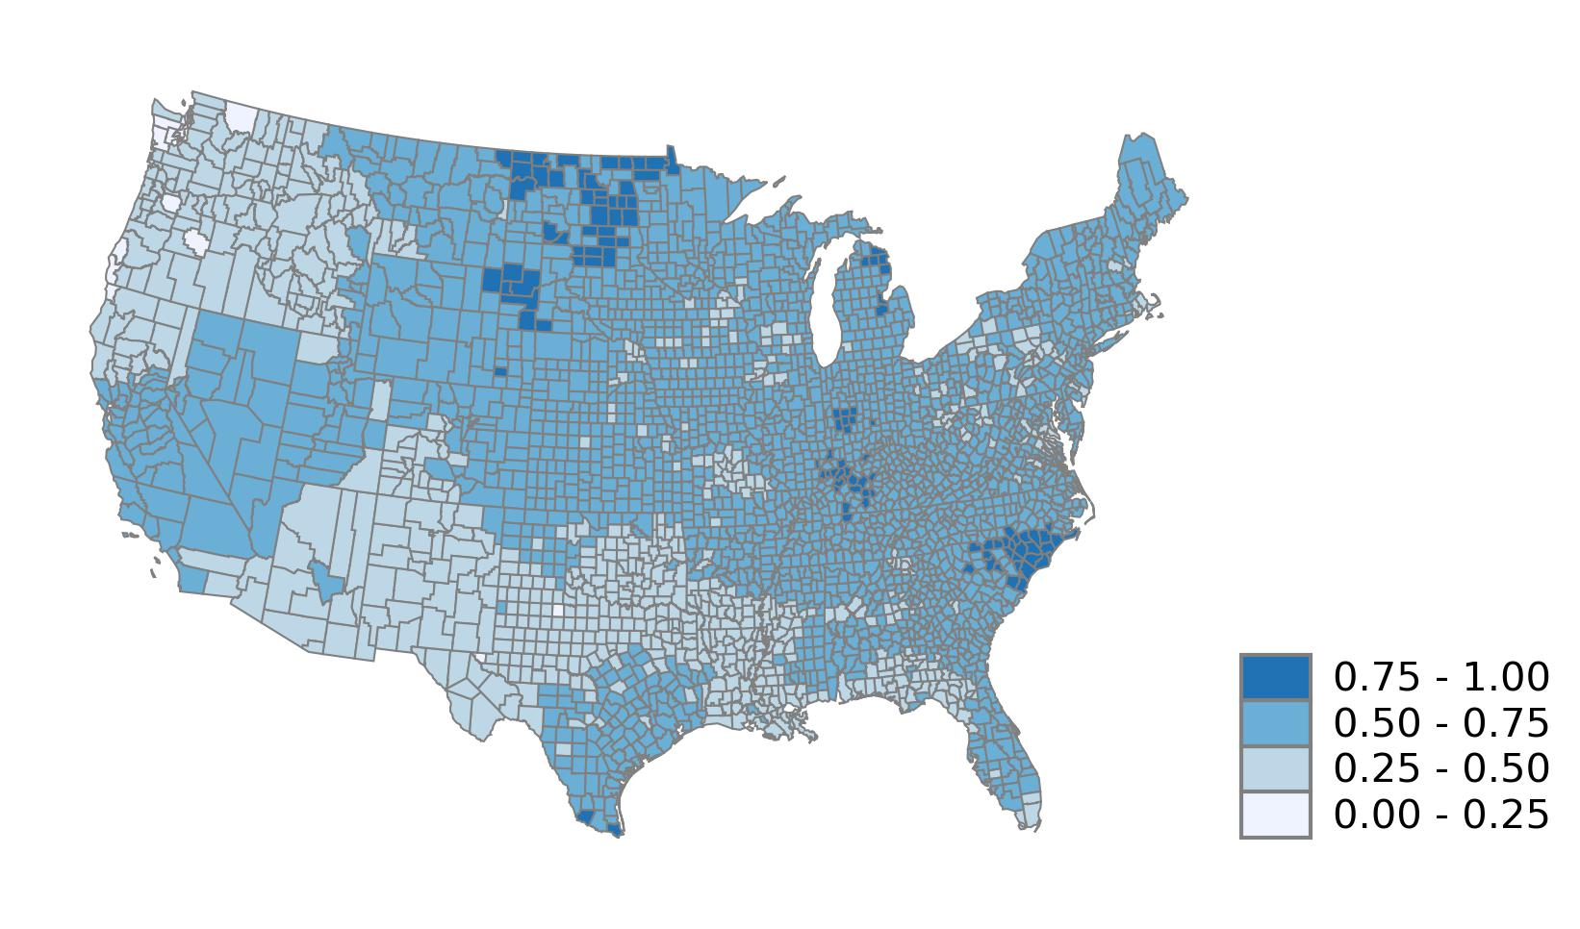
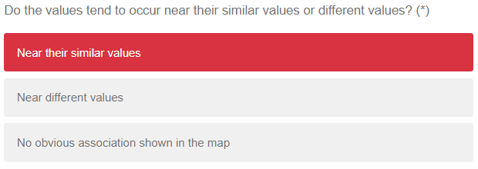
Example 3
The same colors rendering U.S. counties occur near their similar values such as the light blue color in the north west and south of the conterminous U.S.
Notes:
Five map examples

Slide 9
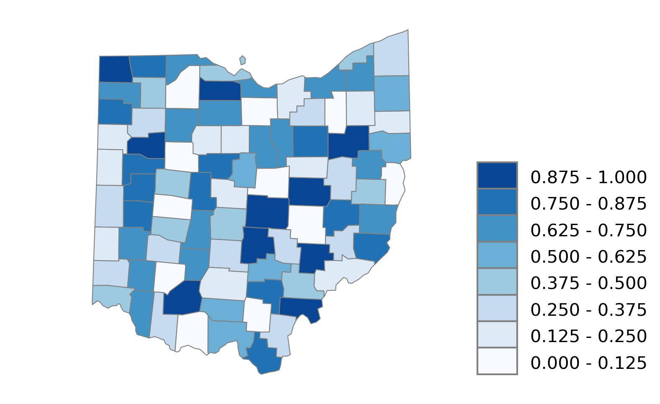
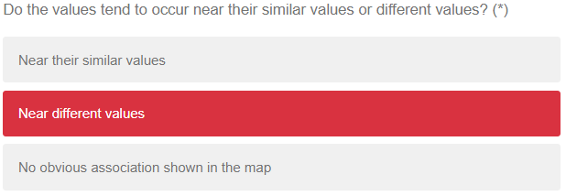
Example 4
The values occur near different values.
For example, the surrounding counties of Morgan county (red box in the map) are small values while Morgan county is rendered with a high value.
Notes:
Five map examples

Slide 10
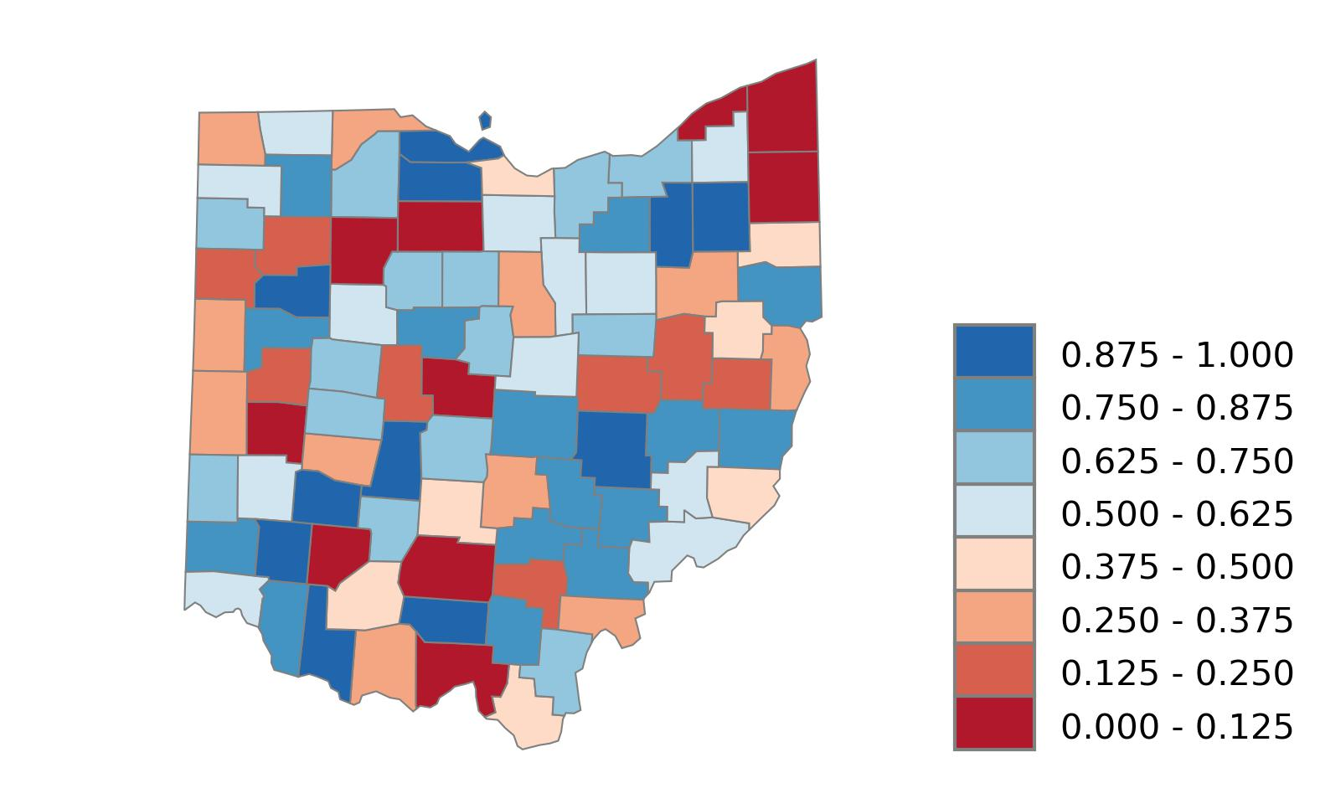
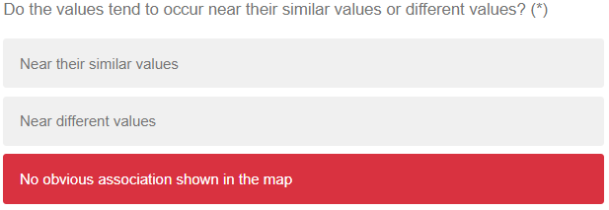
Example 5
There is no obvious association shown in the map.
The surrounding counties of most counties include both high values and low values
Notes:
Five map examples

Slide 11
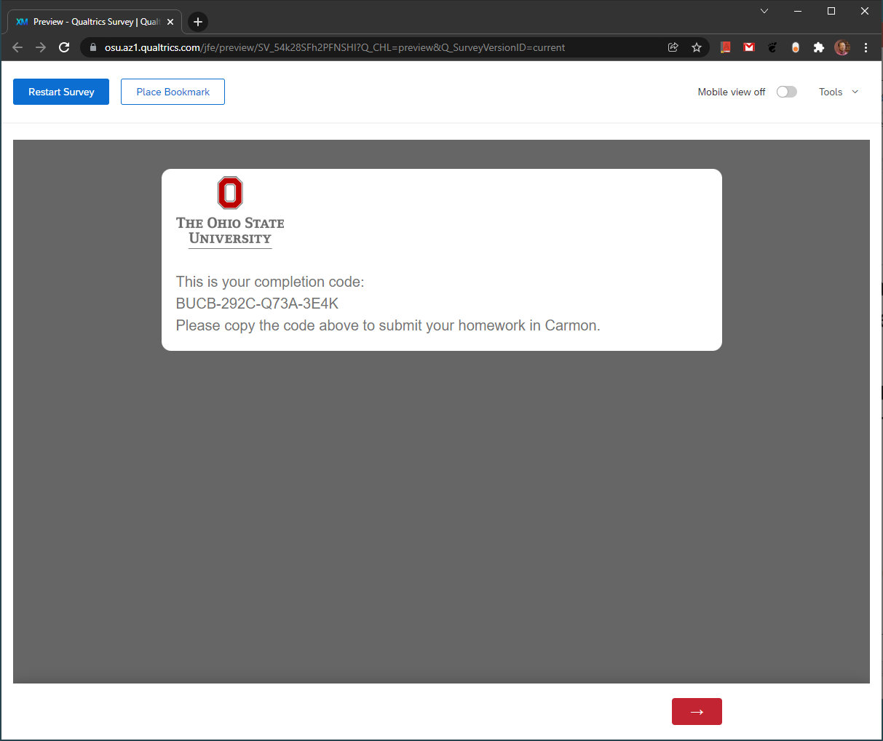
Completion code
If the participant is a student in the geography classes, GEOG 5201 or GEOG 5223, there will be a completion code generated randomly at last.
The completion code will be copied and submitted in his or her Carmen system, serving as the proof to receive bonus credit.

